Slide 1

Stable project
Yijun Shen

Slide 2
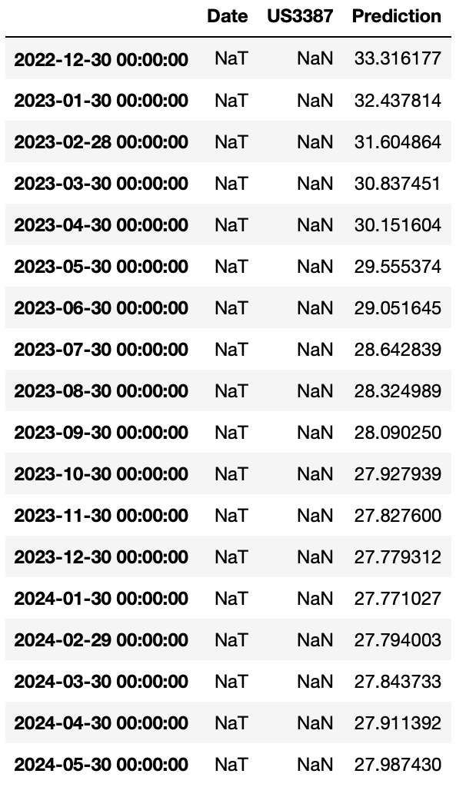
Forecasting Result & Steps
Initially, I was going to generate a SARIMA model.
However, when I check the optimal BIC, AIC and AICC, it seems like the optimal p and q for the dataset are both 0.
Therefore, I had to instead use a LSTM model
I directly fed the whole dataset as training data and generate 18 days prediction
Results are on the left
Personally, I don’t think the prediction is very useful, since the dataset is too stable most of the time, and its variation is extremely low. Therefore, LSTM model cannot learn a lot from the existing historical dataset.

